Slide 1
Bad cell
Good cells

Slide 2

Bad cell
Good cells

Slide 3
Bad cell
Good cells

Slide 4
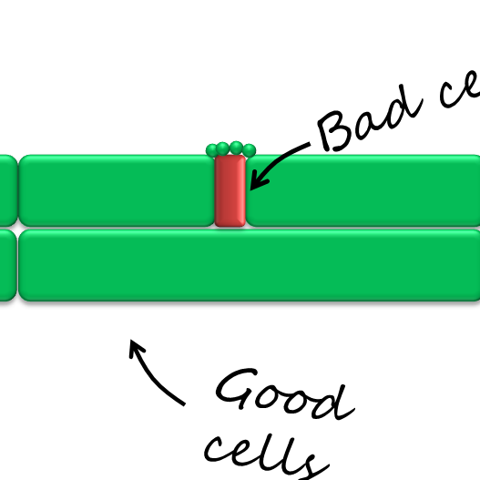

Slide 5
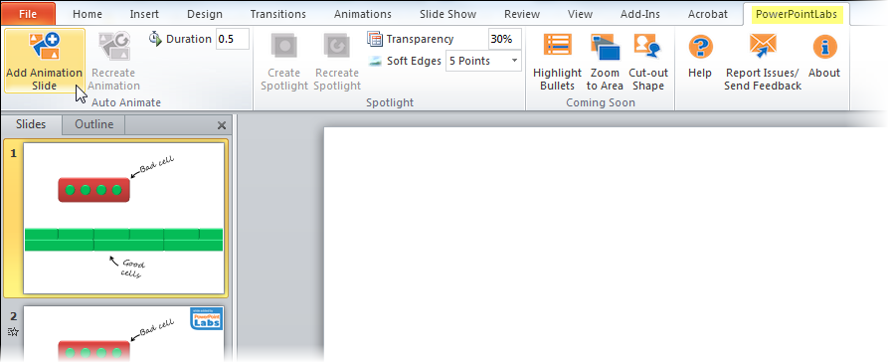
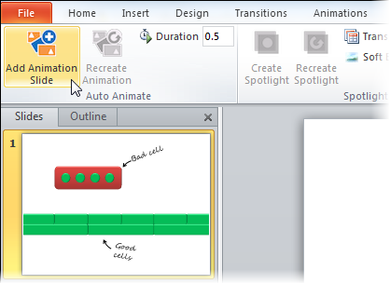

Slide 6
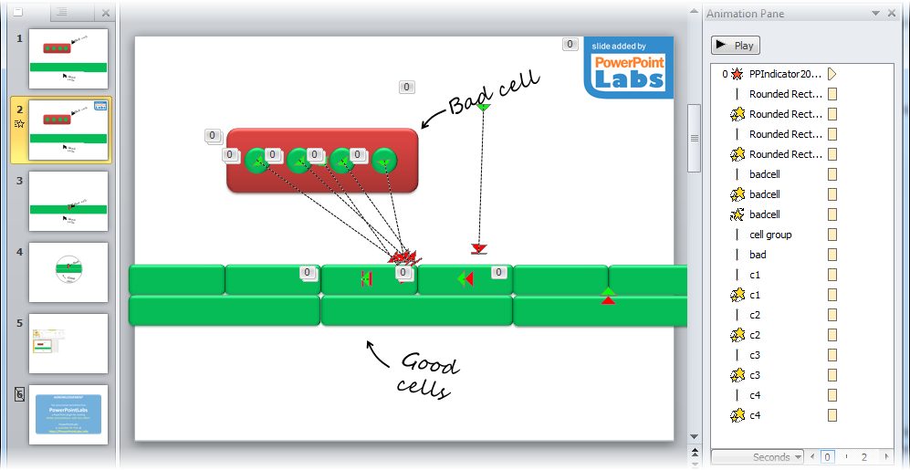

Slide 7



Slide 8


